Slide 1
ACCESS for ELLs 2020
School Assessment Coordinator Training
December 4 or 5, 2019
Assessment, Research, and Data Analysis
Felicia Mallory, Executive Director
Denetra Collins, Staff Specialist

Slide 2
ACCESS for ELLs
2 Main Testing Roles
School Assessment Coordinator
Facilitates the overall administration from start to finish
Test Administrator Administers and Monitors the test

Slide 3
School Assessment Coordinator
Responsibilities
Facilitate overall test administration
Coordinate assignments and communication
Ensure test security
Distribute and assign test materials
Coordinate and schedule test sessions
Ensure everyone completes training and signs administration forms
Account for and return materials to DRC

Slide 4
School Assessment Coordinator
Responsibilities(continued)
Complete Florida’s ACCESS for ELLs Paper Checklist
Review the Spring 2020 Florida ACCESS for ELLs Test Administration Manual
Review applicable sections of the 2020 Florida Accessibility and Accommodations Supplement
Complete the ACCESS for ELLs Paper Administration Quiz passing score of 80% or higher
Provide Parent Notification Letters to students

Slide 5
Test Administrator Responsibilities
Complete Florida’s ACCESS for ELLs Paper Checklist Test Administrator tasks
Review the Spring 2020 Florida ACCESS for ELLs Test Administration Manual
Review applicable sections of the 2020 Florida Accessibility and Accommodations Supplement
Complete the training modules and quiz with a passing score of 80% or higher to become certified to administer the ACCESS for ELLs suite of assessments
Account for and return materials to School Assessment Coordinator
Administer and monitor the test
Provide and document appropriate accommodations for students
Verify student data
Ensure test security

Slide 6

Purposes of ACCESS for ELLs
The results provide:
  Data useful for charting student progress over time
  Diagnostically useful information about students’ strengths and weaknesses in English
  Information about the language proficiency levels of individual students that can be used in making decisions regarding exit from the English for Speakers of Other Languages (ESOL) program
  Identifies the proper ESOL level with respect to English Language Development Standards
  Element included in the new Federal Index

Slide 7
English Language Proficiency and Exit Criteria
State Board of Education Rule 6A-6.09021
ACCESS for ELLs (Grades K–12)
  Proficiency criteria requires students to achieve a Composite Overall Proficiency Level of 4.0 or greater AND at least a Proficiency Level of 4.0 in Reading
Alternate ACCESS for ELLs (Grades 1–12)
  Proficiency criteria requires a student to achieve a Composite Overall Proficiency Level of P1 or greater.
Exit Criteria
State Board of Education Rule 6A-6.0903
  A student must score “Proficient” on the State’s English Language Proficiency Assessment.
    In addition, students in grades 3 – 9 must achieve at least level 3 on the English Language Arts (ELA) component of the FSA
    A student in grades 10 – 12 must either achieve a level 3 or above on the FSA ELA or achieve an appropriate concordant score to satisfy the ELA high school graduation requirement.

Slide 8
ACCESS for ELLs
Suite of Assessments
Basics of ACCESS for ELLs Suite of Assessments
 | Kindergarten ACCESS for ELLs | ACCESS for ELLs Paper | Alternate ACCESS for ELLs
Audience | Kindergarten | Grades 1 – 12 | Grades 1 – 12 who have been identified as ELL with significant cognitive disabilities
Language Domains Assessed | Speaking, Listening, Reading, Writing
Task Format | Selected Response (Listening, Reading) Constructed Response (Writing, Speaking)

Slide 9
ACCESS for ELLs
Basics of ACCESS for ELLs Suite of Assessments
 | Kindergarten ACCESS for ELLs | ACCESS for ELLs Paper | Alternate ACCESS for ELLs
Tiers | Not Tiered | A and B/C | Not Tiered
Administration Format | All domains are individually administered. | Reading, Listening, and Writing group administered. Listening and Speaking are media-delivered via a CD. Speaking is individually administered. | All domains are individually administered.
Adaptivity | Includes stopping rules for when a student hits his/her ceiling. | Tiered forms (A and B/C) are provided to allow students to see items best suited for his/her proficiency level. These forms are fixed. | Semi-adaptive testing includes multiple cues to allow students the opportunity to respond, and stopping rules for when a student hits his/her ceiling.

Slide 10
Students To Be Tested
All students enrolled in the district (grades K-12) and classified ELL, with a code of “LY” on the 1st day of the test administration window, must be administered one of the following English language proficiency assessments:
  Kindergarten ACCESS for ELLs
  ACCESS for ELLs Paper
  Alternate ACCESS for ELLs
TAM, p. 19

Slide 11
Students To Be Tested
Alternate ACCESS for ELLs
A student is eligible to participate in Alternate ACCESS for ELLs if they meet ALL of the following criteria:
1) The student is classified as ELL, with a code of LY or LN on the first day of testing (January 27, 2020).
2) The student has a significant cognitive disability and receives special education services under IDEA (2004).
3) The student requires extensive direct individualized instruction and substantial supports to achieve measurable gains in the grade and age appropriate curriculum.
4) *The student is or will be participating in the Spring 2020 Florida Standards Alternate Assessment (FSAA).
*Note: Only applicable for students in grades 3 – 10.
TAM, p. 20

Slide 12
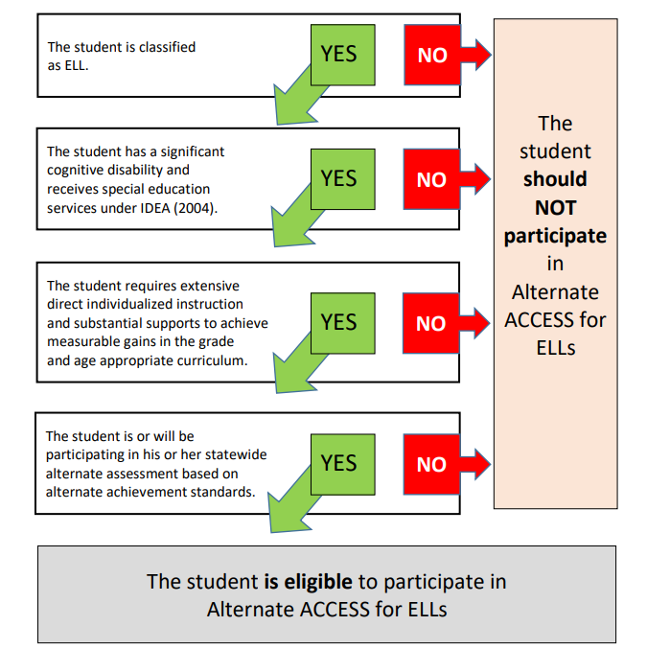
Alternate ACCESS Decision Tree

Slide 13
Students To Be Tested (cont.)
Home Education Program Students
  Students who receive instruction at home, are registered appropriately with their district office as Home Education Program students, and meet the requirement for students to be tested for the 2020 ACCESS for ELLs administration may participate in the administration for their grade level only, as directed by the District Test Coordinator.
  Florida Virtual School Students
  Per Section 1002.37(9)(c), F.S., students enrolled full-time in the Florida Virtual School and who meet the requirement for students to be tested for the 2020 ACCESS for ELLs administration require accommodations for testing in the district in which they reside.
TAM, p. 19

Slide 14

  ACCESS for ELLs assesses students’ English language proficiency in five areas:
  ACCESS for ELLs is reported in four domains listening, speaking, reading, and writing.

Slide 15
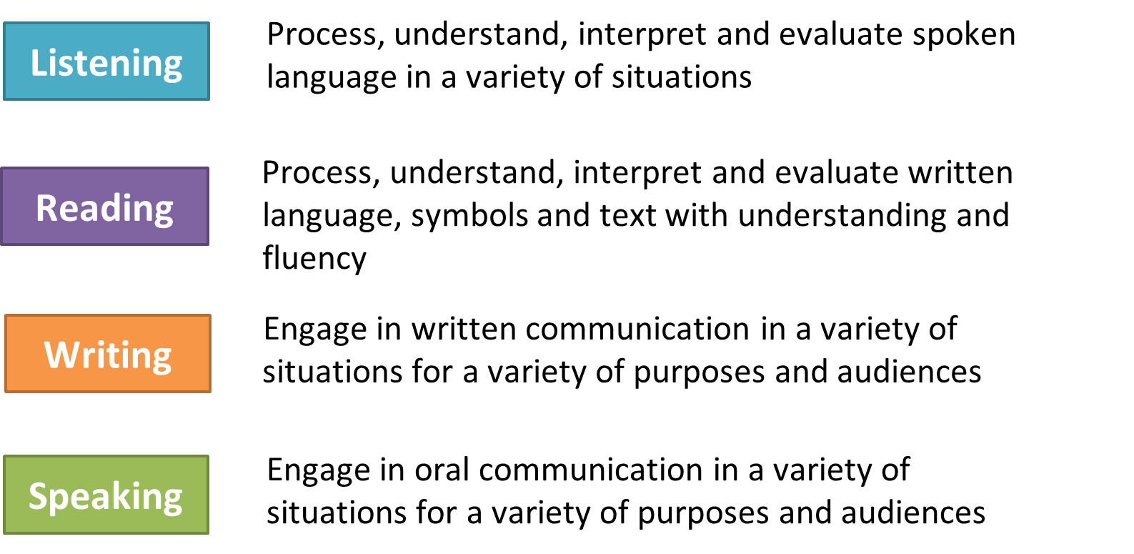

Domains & Grade Level Clusters
*Note: Kindergarten is an interactive, paper-based kit.

Slide 16
Tier Placement Protocol (Grades 1-12)
Tier A - Corresponds to ESOL Level 1
For ELLs who have arrived in the U.S. or entered school in the U.S. within this academic school year without previous instruction in English;
currently receive literacy instruction ONLY in their native language;
have recently tested at the lowest level of English language proficiency.
Tier B/C - Corresponds to ESOL Level 2
For ELLs who have social language proficiency and some, but not extensive, academic language proficiency in English; and/or
have acquired some literacy in English, though have not yet reached grade level literacy.
Tier B/C - Corresponds to ESOL Level 3 or 4
For ELLs who are approaching grade-level literacy and academic language proficiency in the core content areas; and/or
will likely meet the state’s exit criteria for support services by the end of the academic year.

Slide 17
Important Dates for the
2020 ACCESS for ELLs
Suite of Assessments
Administration:
January 27, 2020 – March 20, 2020
Mandatory School Assessment Coordinator Training Meetings:
December 4, 2019 | Ruben Dario Middle
December 5, 2019 | Miami Killian Senior High

Slide 18
Schedule of Activities
Activity | Date
Completion of Test Coordinator & Test Administrator Training on the WIDA Secure Portal | December 12, 2019 (refer to Briefing 26628)
Delivery of Test Materials and Pre-ID labels to Schools | January 13 – 22, 2020
2020 ACCESS for ELLs Test Administration Window Includes Kindergarten and Alternate ACCESS for ELLs | January 27, 2020 – March 20, 2020
Second Set of Pre-ID Labels | Delivery to schools – February 6 – 19, 2020
Return ALL materials “To Be Scored” and “Not to Be Scored” | Call 1-866-857-1501, at least one day prior to the day you will ship your materials. (All materials must be picked up before or on March 20, 2020)
District Coordinator Envelope | Prepare for pick-up May 28 – June 4, 2020
Score report delivery to schools | TBA

Slide 19
Review of Online Training Modules
Conducted by Department of Bilingual Education and World Languages and Department of Exceptional Student Education
(Briefing # 26754)
January 7, 2020 | North: Center for Professional Learning - Kindergarten Central: Everglades K8 Center - Grades 1-5 One-on-One Speaking Section South: Bent Tree Elementary - Grades 6-12 One-on-One Speaking Section 8:30 a.m. – 11:30 a.m. or 12:30 p.m. – 3:30 p.m.
January 8, 2020 | North: Center for Professional Learning - Grades 1-5 One-on-One Speaking Section Central: Everglades K-8 Center - Grades 6-12 One-on-One Speaking Section South: Bent Tree Elementary - Kindergarten 8:30 a.m. – 11:30 a.m. or 12:30 p.m. – 3:30 p.m.
January 9, 2020 | North: Center for Professional Learning – Grades 6-12 One-on- One Speaking Section Central: Everglades K-8 Center - Kindergarten South: Bent Tree Elementary - Grades 1-5 One-on-One Speaking Section 8:30 a.m. – 11:30 a.m. or 12:30 p.m. – 3:30 p.m.

Slide 20
What’s New for Spring 2020
The WIDA website new url address is https://wida.wisc.edu/
The Spring 2020 FLORIDA ACCESS for ELLs Test Administration Manual and the 2020 FLORIDA Accessibility and Accommodations Supplement have replaced the following WIDA manuals:
  2019 – 2020 District and School Assessment Coordinator Manual
  2019 – 2020 Test Administrator Manual
  2019 – 2020 Accessibility and Accommodations Supplement
Test Administrators with training certificates awarded prior to July 2018 must recertify to administer during the Spring 2020 administration.
Students included in the initial Pre-ID file in October will have the Test Assignment (Tier) listed on the Pre-ID label in the District ID field.
Florida’s administration forms are located in the State-Specific Directions document.
ACCESS for ELLs Paper Grades 1 – 12 test forms are available in Unified English Braille (UEB) only, contracted and uncontracted

Slide 21

ACCESS for ELLs Resources

Slide 22
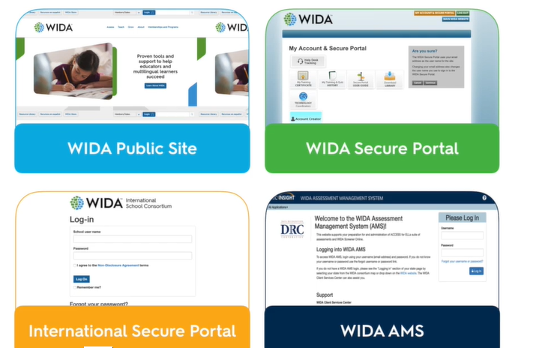
Key WIDA Websites
Access for School Assessment Coordinators and Test Administrators
Access for Principals and School Assessment Coordinators

Slide 23

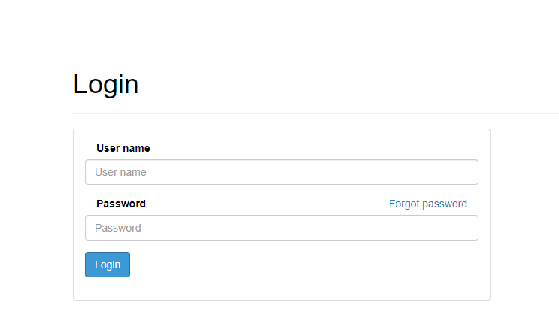
Creating a New Account – WIDA Secure Portal
WIDA Secure Portal New Account Creation Form
Forgot your password? Click log in, then choose “Forgot password”.

Slide 24
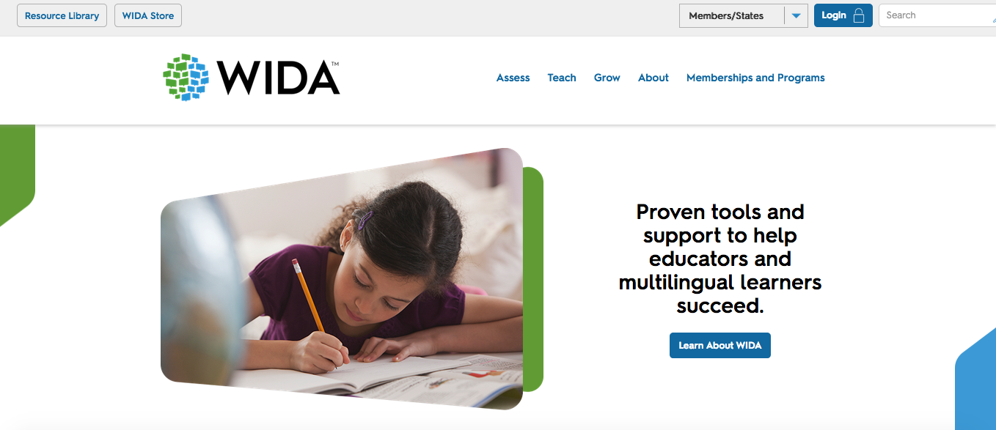
WIDA Website https://wida.wisc.edu/
For more information on WIDA Assessments
Resources for educators and parents

Slide 25
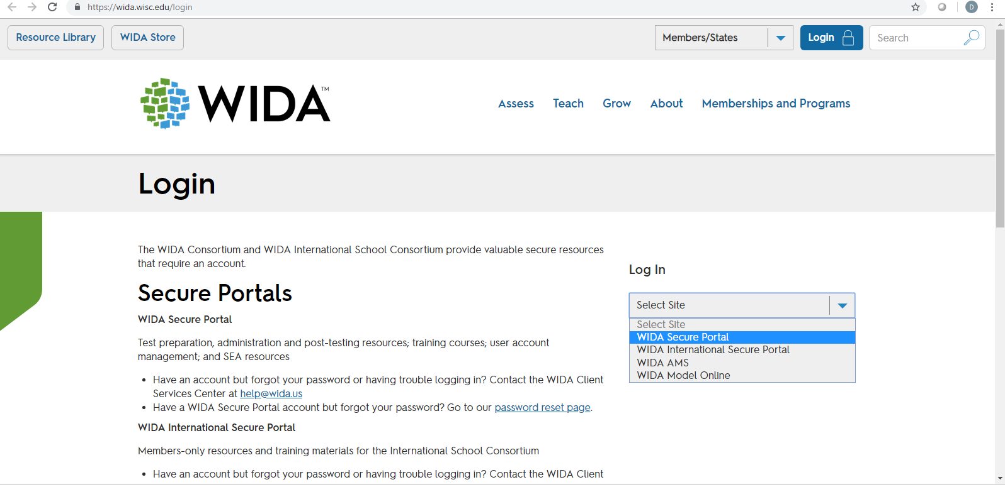
WIDA Website https://wida.wisc.edu/login
Login to WIDA Secure Portal
For more information on WIDA Assessments

Slide 26
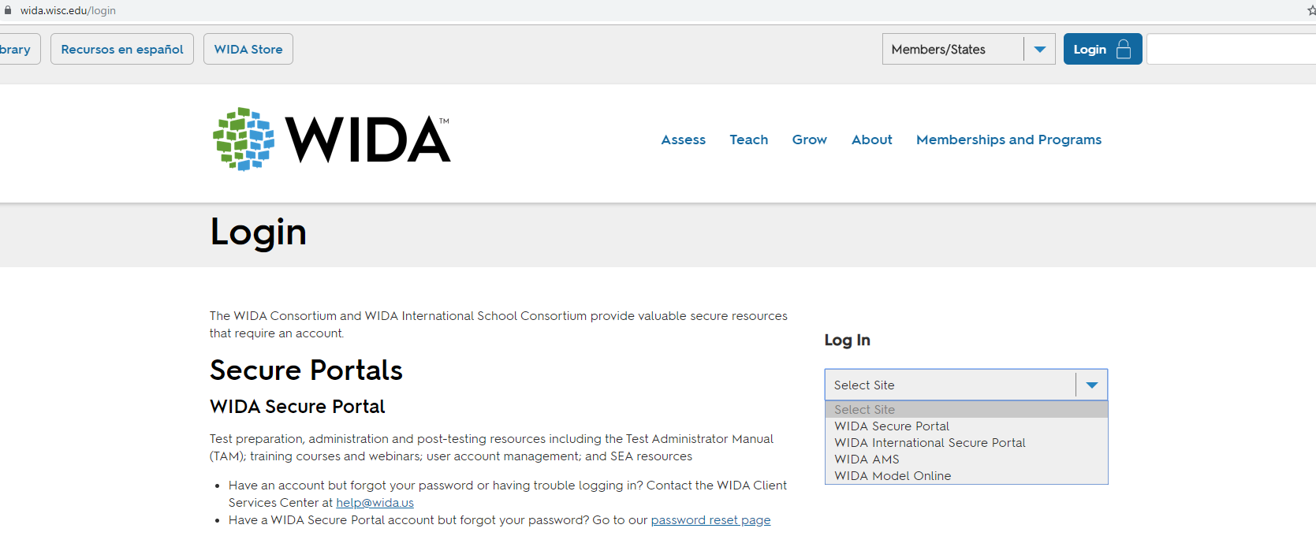
WIDA Website https://wida.wisc.edu/
Log In to WIDA Secure Portal

Slide 27
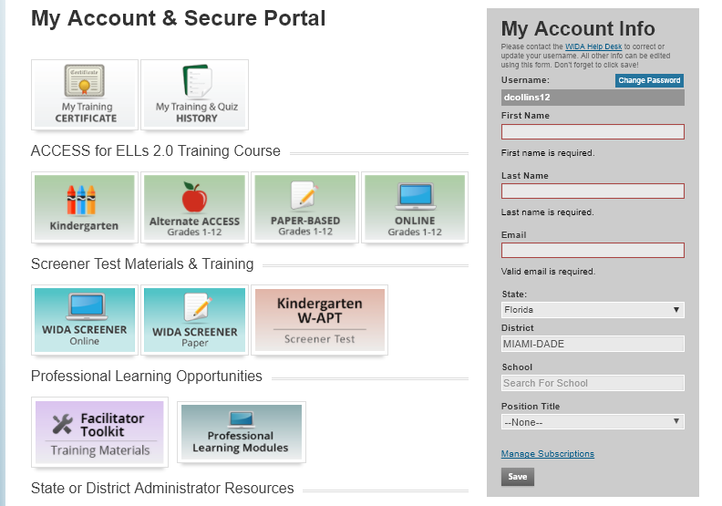
WIDA Secure Portal

Slide 28
Returning Test Administrators
REMINDER
  Test Administrators with training certificates awarded prior to July 2018 must recertify to administer the test during the Spring 2020 administration.
  If the Test Administrator passed the quizzes after July 2018, they should recertify by reviewing the training content for the Kindergarten ACCESS for ELLs, Grades 1-5 Speaking, Grades 6 – 12 Speaking, and Paper Administration Grades 1–12 for the Spring 2020 administration.
School Assessment Coordinators must have Paper Administration 1-12 on their certificate

Slide 29
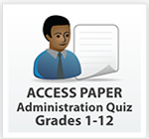

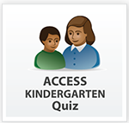

Certification Quizzes
If you are administering… | Then you must take…
ACCESS for ELLs Paper: Listening, Reading, and Writing | Paper General Administration Quiz
ACCESS for ELLs Paper: Speaking | Paper Speaking Quiz for applicable grade cluster(s)
Kindergarten ACCESS for ELLs | Kindergarten Administration Quiz
Alternate ACCESS for ELLs | Alternate Administration Quiz

Slide 30

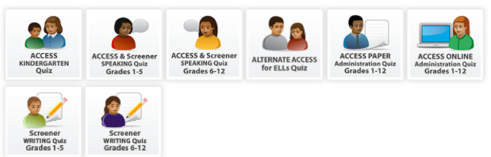
Quizzes for Joaquin Washington
Must complete the online quiz(zes) with a passing rate of
80% or higher to become certified to administer the assessment(s).

Slide 31


Kindergarten
Training and Certification Requirements for Test Administrators
Complete Florida’s ACCESS for ELLs Checklist
Read applicable sections in the Florida ACCESS for ELLs Test Administrator Manual
Online training available via WIDA Secure Portal
Complete the Kindergarten Quiz with a passing rate of 80% or higher to become certified to administer the assessment.

Slide 32



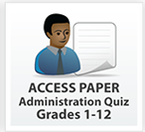
Grades 1-12
Training and Certification Requirements for ACCESS Paper Test Administrators
Complete Florida’s ACCESS for ELLs Paper Checklist
Online training available via WIDA Secure Portal
Complete the online Speaking Quiz(zes) with a passing rate of 80% or higher to become certified to administer the Speaking section.
Must complete the ACCESS for ELLs Paper Administration Quiz with a passing rate of 80% or higher to become certified to administer the assessment.

Slide 33

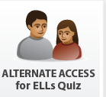
Alternate ACCESS
Training and Certification Requirements for Test Administrators
Complete Florida’s ACCESS for ELLs Checklist
Online training available via WIDA Secure Portal.
Review applicable sections of the ACCESS for ELLs Test Administrator Manual.
Must complete the Alternate ACCESS for ELLs Quiz with a passing rate of 80% or higher to become certified to administer the assessment.

Slide 34
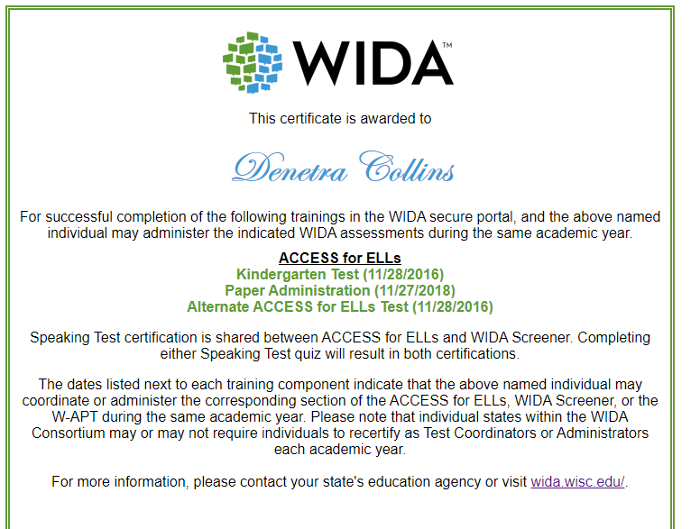


Slide 35
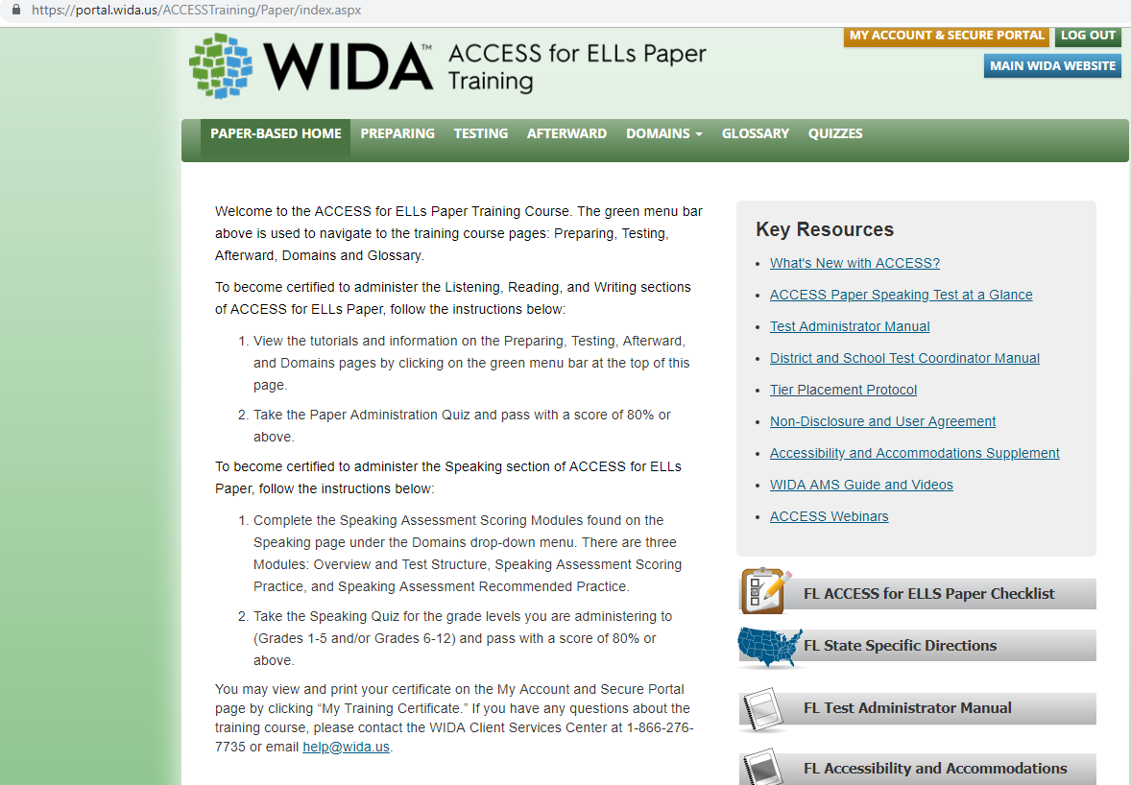
ACCESS for ELLs Paper
Training Webpage
Location for 2020 Florida-Specific Manuals
Notes:
After clicking on the Paper-Based Grades 1 -12 button you will see…this page.
Please remember only use the documents at the bottom right of the page that state Florida first.
Click the headings at the top of the page for access to the training materials.
They are Preparing, Testing, Afterward, Domains, and once those are completed, they should then complete the appropriate quizzes.

Slide 36
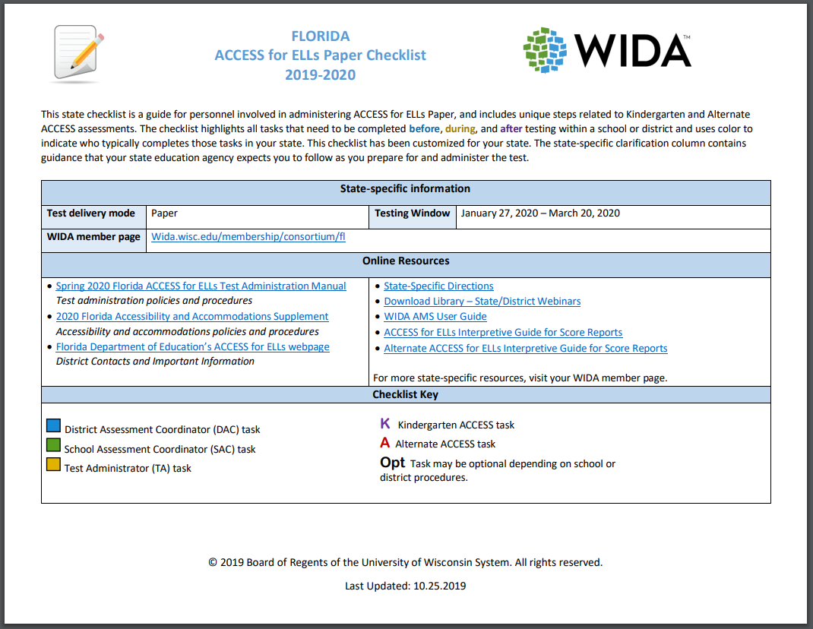

Florida’s ACCESS for ELLs Checklist
District Test Coordinators, School Assessment Coordinators , and Test Administrators
Available on Florida's WIDA webpage
and the
Paper-Based Training
tile.

Slide 37
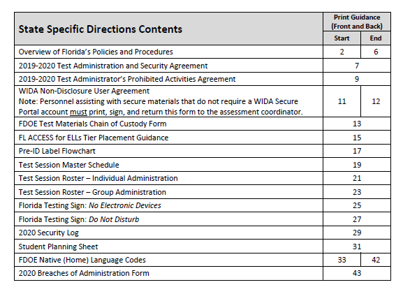
State Specific Directions Document Contents

Slide 38
Spring 2020 Florida ACCESS for ELLs Test Administration Manual
This manual explains all responsibilities and tasks related to the implementation and administration of the ACCESS for ELLs suite of assessments in Florida.

Slide 39
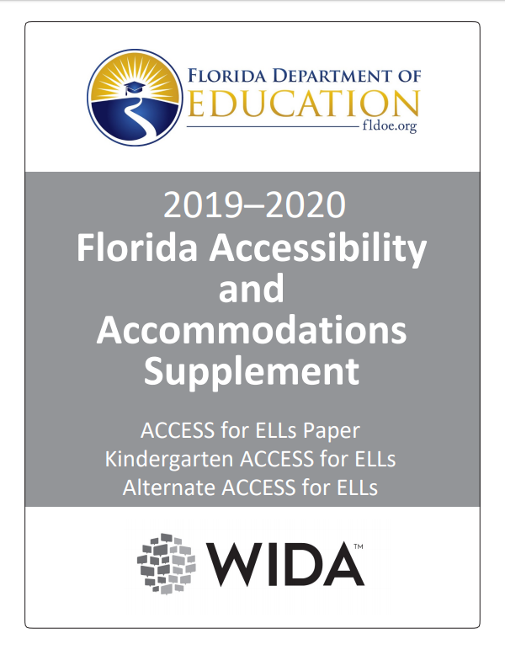
2020 Florida Accessibility and
Accommodations Supplement
This document highlights test administrative considerations, universal tools, and accommodations for individual ELLs taking the paper-based tests.
Accommodation Selection Forms located in Appendix C and on Florida’s WIDA Webpage.

Slide 40
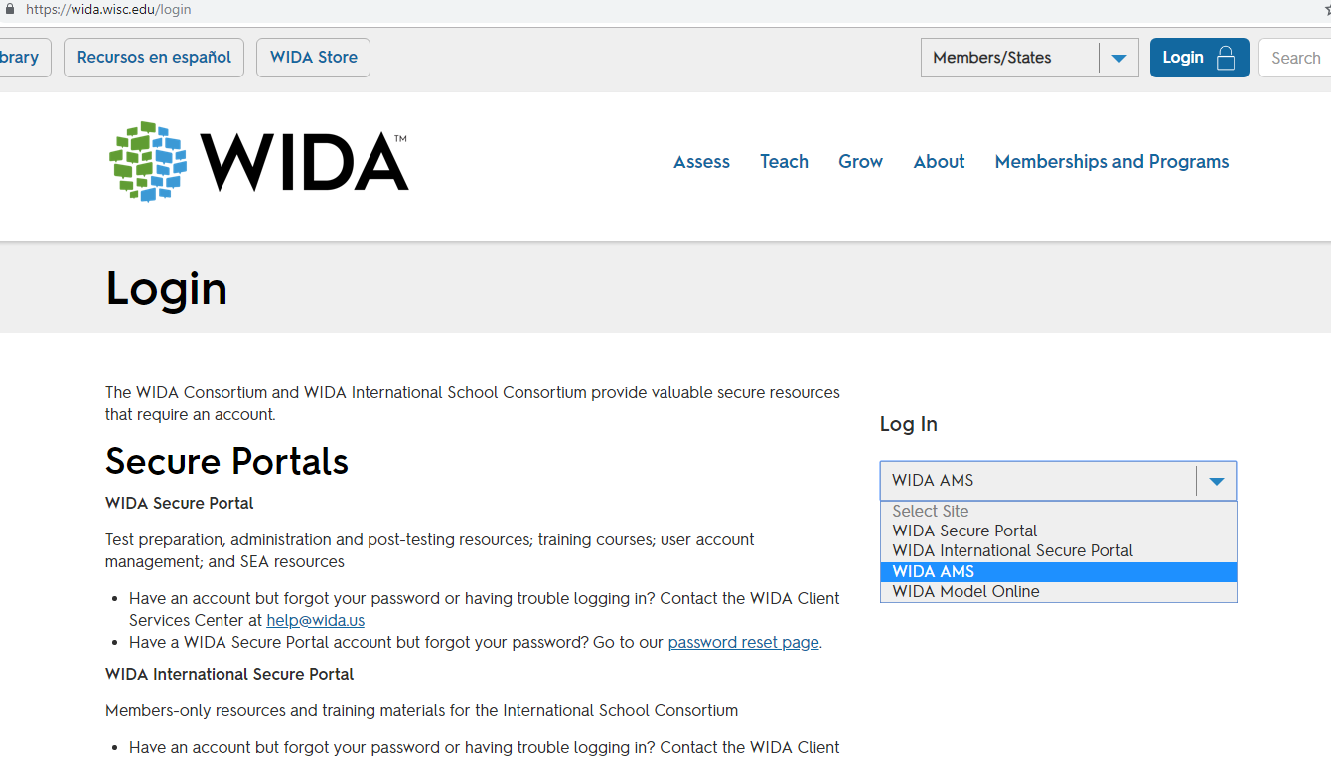
WIDA AMS Website
https://wida.wisc.edu/login

Slide 41
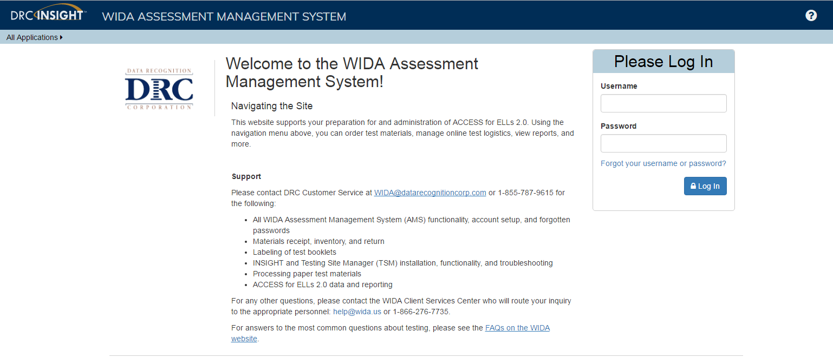
WIDA Assessment Management System
www.wida-ams.us
Before and During Testing
Electronic copies of packing lists and security checklists
After Testing
School Roster Reports
Individual Student Reports
To access: All Applications Report Delivery Test Results

Slide 42
SCHOOL ASSESSMENT COORDINATOR:
MANAGING MATERIALS

Slide 43

Follow Test Security Policies
Test Content Remains Secure
No specific information about the content of the test is shared
Keep personal login information secure.
Place all secure materials in locked storage.
Do not duplicate any test materials (exception of the FL TAM).

Slide 44
Inventory Test Materials
Delivery to Schools:
January 13-22, 2020
Test materials and Pre-ID labels are delivered to the districts for distribution to schools.
  Note: All test Materials including Kindergarten ACCESS for ELLs and ACCESS for ELLs will be packaged in yellow boxes.
  Last Box (highest numbered box) in Shipment Contains:
    School Packing List
    Security Checklist to track secure materials
    Student Booklet Labels (Pre-ID, District/School, and Do Not Process)

Slide 45
Preparing for Testing:
Receiving Materials
Verify that all materials indicated on the packing list were received.
Notify the Student Assessment immediately if any of the materials on the packing list are missing.
Should you need to order additional materials, please see procedures
Store materials in a secure access-restricted location.
Retain ALL boxes in which materials were received for return (except the ones which contained large print and Braille documents).

Slide 46
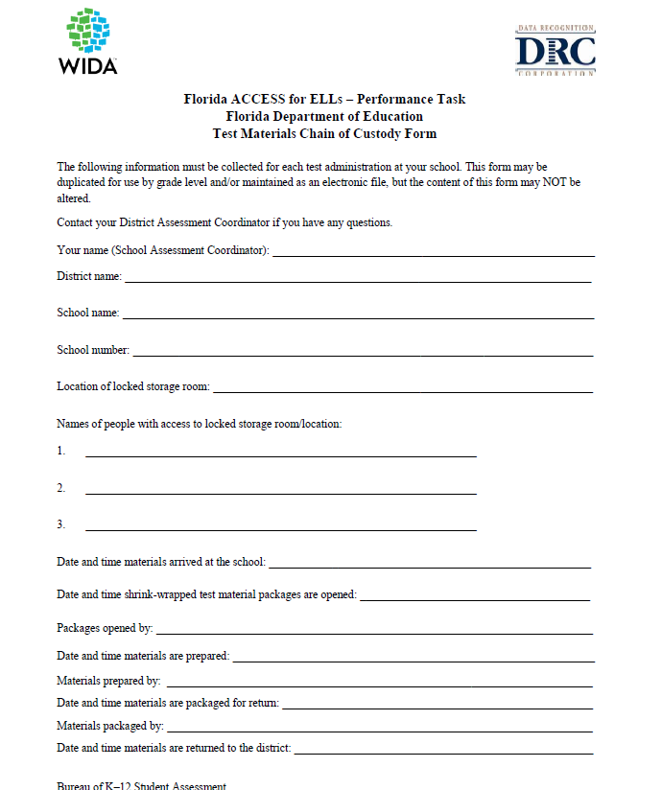
Chain of Custody Form

Slide 47
Ordering Additional Materials
Paper-Based Tests
  All additional orders will be placed online through Google Forms.
    http://oada.dadeschools.net/TDC/TDC.asp
    The link is available under the “Test Distribution Center Documents (TDC Documents)” section, then under Order Forms.
  Please allow 24 hours for TDC to process your order if placed before 3:00 pm. Orders placed after 3:00 pm will require 48 hours for processing.
  Note that any secure materials picked up at TDC must be taken directly to the school site for secure storage. Please refrain from picking up materials, late in the day, on your way home.

Slide 48

Ordering Additional Materials
Available for:
  ACCESS for ELLs - Grades K-5
  ACCESS for ELLs - Grades 6-12
  ACCESS for ELLs – Accommodated Forms
  ACCESS for ELLs - Alternate
  ACCESS for ELLs - Human Reader Scripts
Notes:
Not to self:
Make sure to change titles on the website

Slide 49
Preparing for Testing – Materials (Non-Secure)
The shipment will include:
Packing list | Security Checklist
Student Booklet labels | Return Materials Instruction Packet
Plastic bags for materials return
TAM, pp. 42 - 43

Slide 50
Preparing for Testing – Materials (SECURE)
The shipment will include:
Test Administrator's Scripts | Speaking Test Booklets
Student Response Booklets (Reading, Writing, Listening, and Speaking Responses) | Listening and Speaking CDs
Kindergarten Ancillary Kit - Student Storybook - Activity Board - Cards and Card Pouch | Human Reader Accommodation Recording Script (if applicable)
Alternate Test Booklet (if applicable) | Large Print Test materials (if applicable)
 | Unified English Braille (UEB) Test materials (if applicable)
TAM, pp. 44 - 46

Slide 51
Preparing for Testing:
Scheduling Test Sessions
Schedule grade K testing and the Speaking section (grades 1 – 12) for individual administration.
Individually administered sections may be
administered at anytime during the testing window.
Group administration takes place at anytime during the testing window.

Slide 52

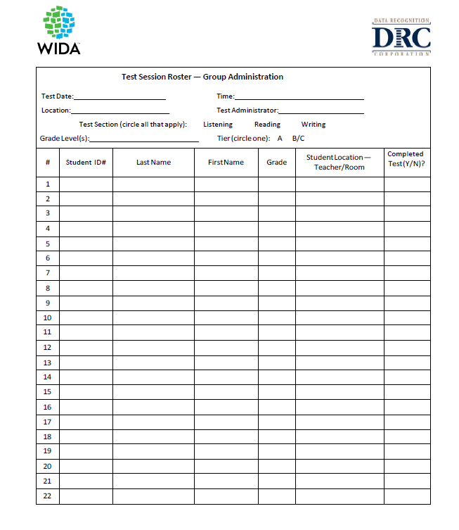
Group by Grade Cluster & Tier
Groups must be made up of the same grade-level cluster.
and
Groups must be made up of the same tier (A or B/C) on the Test Session Roster.
TAM, p. 54

Slide 53
Group Size
WIDA recommends:
No more than 22 students in a group
Smaller groups for new students to the school
Keeping the same group together for all domains
This eliminates the need create a new roster for each test session. This avoids the need to reorganize test booklets after each session.

Slide 54
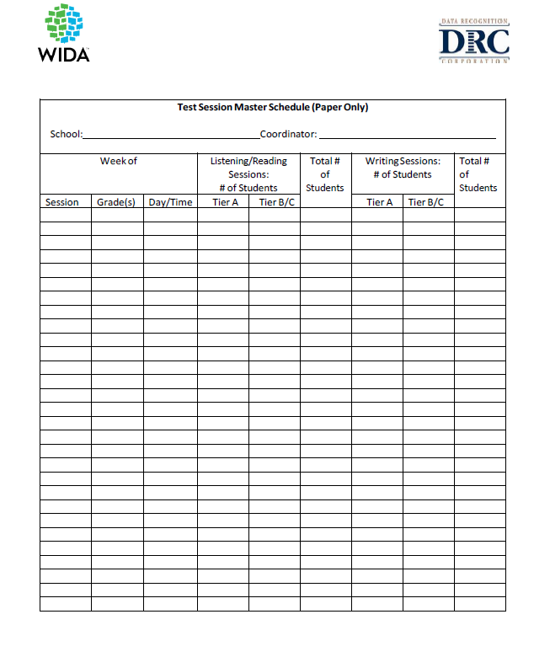
Schedule Paper Test Sessions
Master Form
Separate Sessions by Grade Cluster, Tier, and Domain
(No more than 22 students per session):
Grades 4-5, Tier B/C, Reading
Grade 2, Tier A, Listening
Grade 1, Tier A, Writing
Test Sessions Forms available in State Specific Directions Document

Slide 55
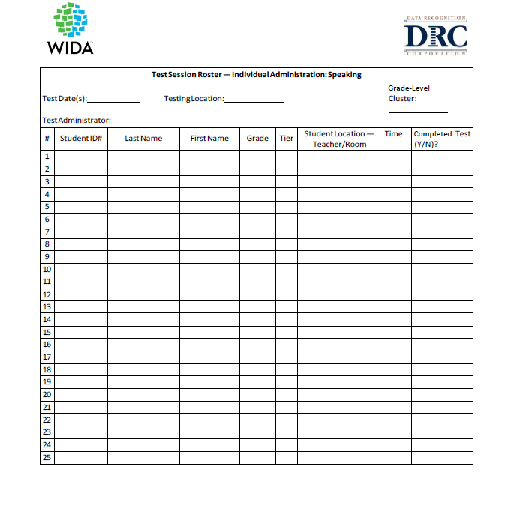
Preparing for Testing:
Scheduling
Group
Individual – Speaking
Test Session Scheduling considerations:
No more than 22 students in a group-testing session
Schedule ONLY ONE tier in a single test session (A or B/C)
Schedule ONLY ONE grade-level cluster in a single test session
NOTE: A roster should include ONE grade-level or cluster and ONE tier

Slide 56

Assigning and Tracking Materials
Test Administrator signs in/out materials.

Slide 57
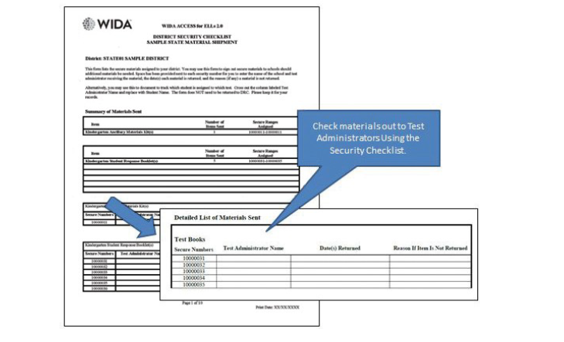
Managing Test Materials:
Distributing and Tracking
Security Checklist

Slide 58
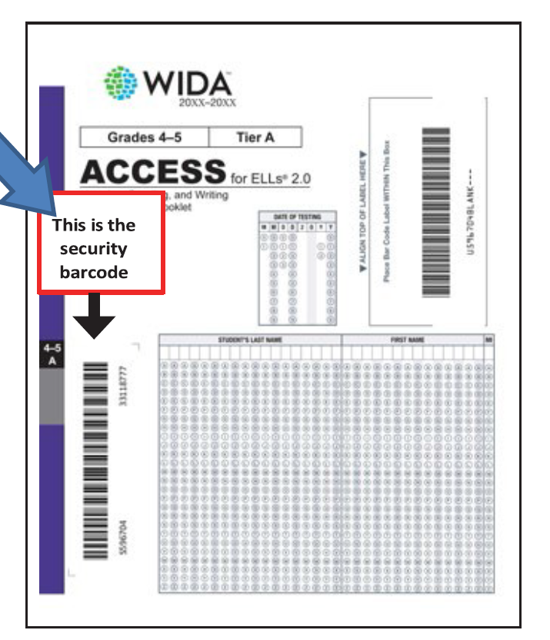
Managing Test Materials
Security Barcode
TAM, p. 50

Slide 59
SCHOOL ASSESSMENT COORDINATORS:
MANAGING STUDENT INFORMATION

Slide 60
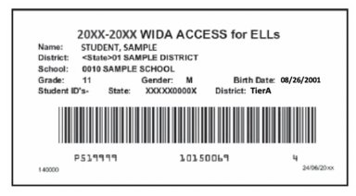
Preparation and Verification
of Pre-ID Labels
NEW
Test assignment (Tier) on label
Sample Pre-ID label
The following information MUST be correct for the student Pre-ID label to be used:
    Student State ID (FLEID)
    District Number
    School Information
    Do NOT make any markings on the Pre-ID label.
TAM, pp. 7 & 28

Slide 61
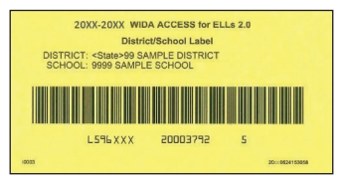
Preparation of Testing Materials:
District/School Labels
Sample District/School Label
**USED FOR STUDENTS WHO DO NOT RECEIVE PRE-ID LABELS**
Verify that the District and School are correct on the yellow label before using it.
This label is placed in the box located in the upper right hand corner on the front of the booklet where the Pre-ID label would go.
Use the directions outlined on pages 34-37, Completing Demographic Information (Section 4.6).
You will receive one label for every test booklet ordered, plus an overage.
TAM, p. 29 & 34 - 37

Slide 62
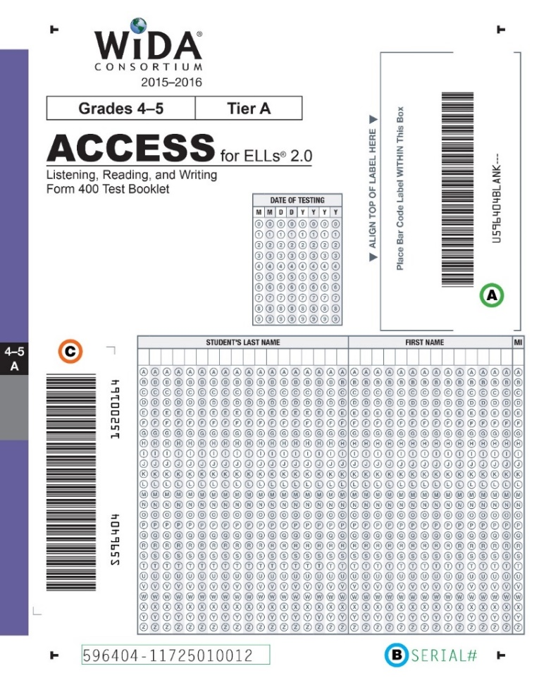

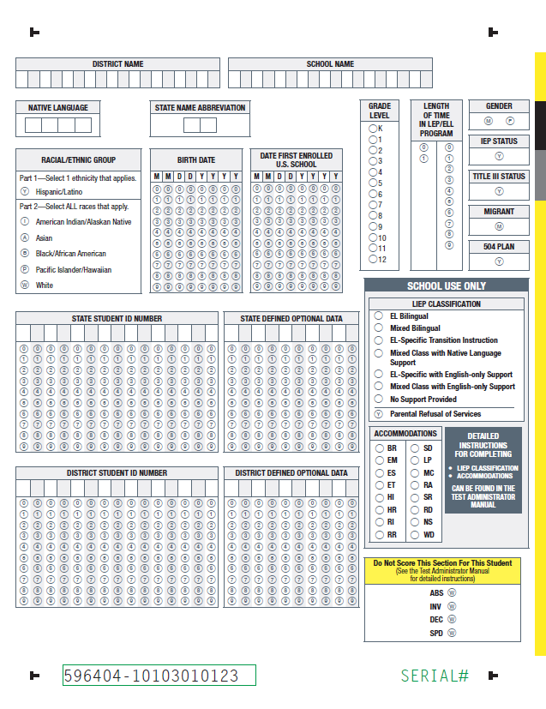
Assigning Test Booklets to Students
Apply Verified Pre-ID Labels to Box A
Use only a #2 pencil to grid student demographic information on the front and/or back covers.
Front Cover
  Must bubble and grid the date that testing began for the student. (i.e., 01/28/2020)
Back Cover (as applicable):
  Accommodations
  Do Not Score This Section
Box A

Slide 63
2nd Wave of Pre-ID Labels Procedures
Delivery Date (to schools): February 6 -19, 2020
If a student did not receive a Pre-ID Label within the initial shipment, there may be a chance he or she will receive a label during the 2nd Wave.
Meanwhile, schools can proceed with testing the student after affixing a District/School Label to Box A and gridding the following:
  Date of Testing (begin date)
  Student Last Name
  Student First Name
  District Name (Code)
  School Name (Code)
  State Student ID Number (FLEID)
(continued on next slide)

Slide 64
2nd Wave of Pre-ID Labels Procedures (continued)
If a new Pre-ID Label is provided in February, place over the District/School Label and submit to DRC for scoring.
  Leave the following demographic information as-is:
    Date of Testing
    Student Last Name
    Student First Name
    District Name (Code)
    School Name (Code)
    State Student ID Number (FLEID)
  If applicable, grid Accommodations and/or Do Not Score Codes.
(continued on next slide)

Slide 65
2nd Wave of Pre-ID Labels Procedures (cont.)
If a new Pre-ID Label is NOT provided, proceed to complete the following information:
  Native Language
  Race
  Ethnicity
  Date First Enrolled in a US school
  Length of Time in LEP/ELL Program
  IEP Status
  Title III Status
  Migrant
  504 Plan
  LIEP Classification
  Accommodations (if applicable)
  Do Not Score Codes (if applicable)
TAM, pp. 29-34

Slide 66
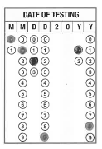
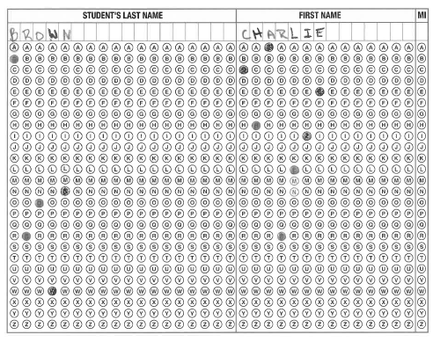

Completing Demographic Information
Front Cover
Date of Testing (Box 2)
Grid the date testing began for student.
Valid Dates:
January 27 – March 20, 2020
Student Name (Box 3)
Grid one letter in each box and completely fill in each of the corresponding bubbles below the letters of the student’s name.
For a hyphenated name leave a blank space where the hyphen is and bubble nothing below it.
TAM, p. 34

Slide 67

Completing Demographic Information
Back Cover
District Name (Box 4)
Starting at the left, print the district two-digit code number, putting one number in each box. Leave the 16 remaining boxes blank.
School Name (Box 4)
Starting at the left, print the school four-digit code number, putting one number in each box. Leave the 14 remaining boxes blank.
1
3
Continued on next slide
TAM, pp. 34 - 35

Slide 68
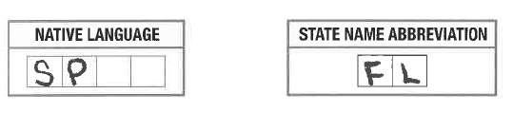
Completing Demographic Information
Back Cover (cont.)
Native Language (Box 5)
Starting at the left, print the student’s native (home) language two-letter code (as defined in the State-Specific Directions), putting one letter in each box (i.e., Spanish = SP). Leave the two remaining boxes blank.
State Name Abbreviation (Box 6)
Print the two-letter (FL) state name abbreviation for Florida.
Continued on next slide
TAM, p. 35

Slide 69
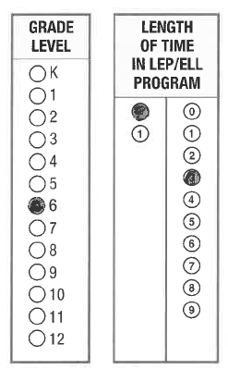
Completing Demographic Information
Back Cover (cont.)
Grade Level (Box 7)
Bubble the grade level for the student.
Important: Incorrect Grade level will impact reporting.
Length of Time in LEP/ELL Program (Box 8)
Starting at the left, fill in the number of years (rounded down) a student has been enrolled in an LEP or ELL program. If the student has been in the program less than a year, fill in 00; one year, 01; two years, 02; etc. Fill in one bubble in each column.
Continued on next slide
TAM, p. 35

Slide 70
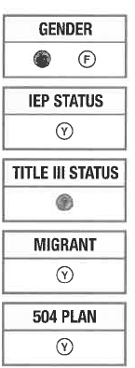
Completing Demographic Information
Back Cover (cont.)
Gender (Box 9)
Fill in the M bubble if the student is male, or the F bubble if the student is female.
IEP Status (Box 13)
Fill in the Y bubble if the student has been identified as having an Individualized Education Program under the Individuals with Disabilities Education Act.
Title III Status (Box 14)
Fill in the Y bubble if the student is part of the district’s Title III, ESSA allocation.
Migrant (Box 15)
Fill in the Y bubble if the student is defined legally as a migratory agricultural worker under ESSA 2015. Classification as a migratory child requires the National Certificate of Eligibility (COE) form to be on file.
504 Plan (Box 16)
Fill in the Y bubble if the student has been identified as having special educational needs as defined in the Rehabilitation Act and Americans with Disabilities Act.
Continued on next slide
TAM, p. 35

Slide 71
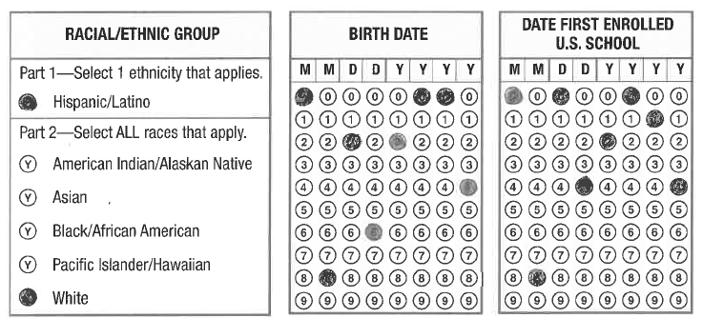
Completing Demographic Information
Back Cover (cont.)
Racial/Ethnic Group (Box 10)
Part 1: If a student is Hispanic/Latino, fill in the Y bubble.
Part 2: Select all races that apply for the student.
Birth Date (Box 11)
Starting at the left, bubble in the student’s birth date.
Date First Enrolled U.S. School (Box 12)
Starting at the left, bubble the date the student enrolled in a U.S. school.
Continued on next slide
TAM, p. 35

Slide 72
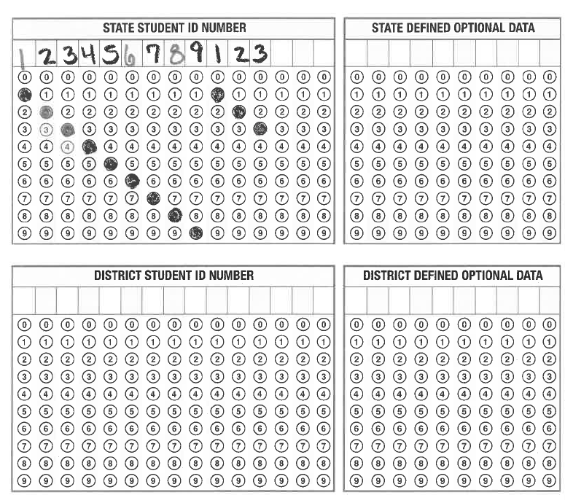
Completing Demographic Information
Back Cover (cont.)
State Student ID Number (Box 17)
For students who do not receive a Pre-ID Label
Starting at the left, print only the 12 numeric characters of the Florida Education Identification (FLEID) assignment for the student. Leave the remaining boxes blank.
Important: Do not include the "FL" in this field.
State Defined Optional Data (Box 18)
Leave this field blank.
District Student ID Number (Box 19)
For students who do not receive a Pre-ID label, starting at the left, print the assigned District Student ID number and bubble corresponding numbers. Leave any remaining boxes blank.
District Defined Optional Data (Box 20)
Leave these fields blank.
Continued on next slide
TAM, p. 35

Slide 73
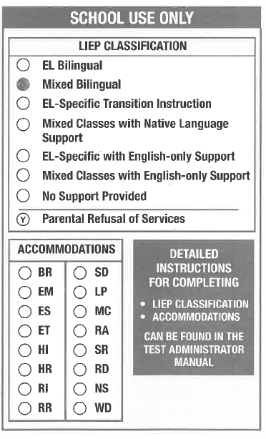
Completing Demographic Information Back Cover (cont.)
LIEP Classification (Box 21)
Fill in the bubble next to the Language Instruction Educational Program (LIEP) Classification that best applies to the student.
For a cross-walk of Florida instructional model/approach and the LIEP Classifications, please refer to page 36 of the Spring 2020 Florida ACCESS for ELLs Test Administration Manual.
NOTE: EL Bilingual, Mixed Class with Native Language Support, No Support Provided, and Parental Refusal of Services are not applicable LIEP Classification codes for Florida.
Accommodations (Box 22) (Pre-ID and District School label, if necessary)
Fill in the bubble next to any accommodation that applies to the student even if a Pre-ID or District/School Label is affixed to the student response booklet.
For detailed information on the available accommodations for each assessment, please refer to the 2020 Florida ACCESS for ELLs Accessibility and Accommodations Supplement.
Continued on next slide
TAM, p. 36

Slide 74
Completing Student Information on Test Booklet
Boxes to complete:
Student with Pre-ID Label | Students with District/ School Label
1, 2, 3, 22 (if applicable), 23 (if applicable) | 1, 2, 3, 4, 5, 6, 7, 8, 9, 10, 11, 12, 13, 14, 15, 16 (if applicable), 17, 19, 21, 22 (if applicable), 23 (if applicable)

Slide 75
Test Invalidation Procedures
The appropriate INV bubble MUST be gridded if:
  A student has an electronic device during testing or during a break within a test session.
  A student becomes ill during testing and does not complete the session.
  A student engages in inappropriate testing practices (i.e. cheating; Report is needed).
  A student is not allowed the correct amount of time to finish the test session by the test administrator.
  A student is given an accommodation not allowed on the statewide assessment.
  A student is given an accommodation NOT indicated on the student’s IEP or
  Section 504 Plan.
  7) A student was not provided an allowable accommodation which was indicated
  on the student’s IEP or Section 504 plan.
  8) A student is disruptive during testing.
  An error occurs in the test administration procedures that could compromise
  the validity of the test results.
  10) A major disruption occurs during testing (contact Student Assessment).
  A student is given unauthorized assistance during testing.
TAM, pp. 39 - 40

Slide 76
Test Invalidation Procedures (continued)
Do NOT use the INV bubble if there is a DO NOT PROCESS label affixed to the document AND:
  The preidentified document belongs to a student who has withdrawn from the school prior to testing.
  The preidentified document belongs to a student who has been absent during the entire test administration window.
  The preidentified information is incorrect and the document is UNUSED.
  The preidentified document is USED and defective.
TAM, pp. 36-37

Slide 77
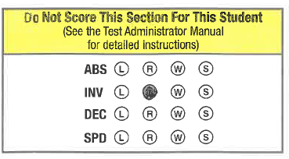
Completing Demographic Information
Back Cover (cont.)
Do Not Score This Section For This Student (Box 23)
Filled-in bubbles in this field indicate a special circumstance. If any of these bubbles are filled in, the student will receive a score of “NA” for that domain.
The Test Administrator should discuss any situation that may involve gridding a Do Not Score Code with the School Assessment Coordinator.
*Important: Do Not Score Codes are not the same as the Do Not Process Label*
Continued on next slide
TAM, pp. 37, 39 - 40

Slide 78
Completing Demographic Information
Back Cover (cont.)
Do Not Score Codes
Absent (ABS): Absent indicates the student was absent for a domain of the test; if so, fill in the appropriate bubbles for the domain the student did not take.
Invalidate (INV): Invalidate indicates that even though a student may have completed some or all of the test items, the testing was not valid. For assistance identifying circumstances when invalidations in an appropriate course of action, please review section 4.7 of the Spring 2020 Florida ACCESS for ELLs Test Administration Manual.
Declined (DEC): Declined indicates a student refused to test. This annual state assessment is NOT an optional activity. It is a required activity. A student cannot opt out of the state’s annual assessment. This indicator is used only when a student refuses to participate even after the Test Administrator has made several attempts to engage the student in the assessment. In this event, fill in the appropriate bubble(s).
Exemption (SPD): Deferred Special Education/504 indicates that an IEP or 504 team determined that the student should defer participation from one or more of the domains of this test; if so, fill in the appropriate bubbles.
TAM, pp. 37 & 39 - 40

Slide 79
PROCEDURES FOR STUDENT TRANSFERS
Transfer Situation | What To Do
Student completes all domains in a school but transfers out of the school or the district (within the state) | Completed Student Response Booklets should be returned as normal by the site in which the student completed the test. No further action is needed.
Student completes all domains in a school but transfers out of state | Completed Student Response Booklet should be returned as normal by the site in which the student completed the test. No further action is needed.
Student transfers to a new school within the district during testing and has completed one or more domains. In addition, the district permits the secure transfer of partially completed booklet from the original school to the new school | Not Permitted in Miami-Dade County Public Schools
Student transfers to a new school within the district during testing and has completed one or more domains; however, the district does not permit the secure transfer of partially completed booklet from the original school to the new school | The original school should submit for scoring as-is. The new school may proceed to administer ONLY domains that the student has not been previously assessed. At the new school, affix the District/School label on a new student response booklet and bubble the student demographic information. Important: The student’s name, FLEID, birth date, and grade must match in order to merge the two student response booklets and generate a complete score report.
TAM, pp. 58 - 59
Transfer Situation | What to do
Student transfers out of the state or district prior to the testing window | Destroy the Pre-ID label. If the Pre-ID label is already affixed to a student response booklet, place a Do Not Process label over the Pre-ID label and return to DRC. No further action is needed
Student transfers out of school or district, but within the state, prior to testing | Destroy the Pre-ID label. If the Pre-ID label is already affixed to a student response booklet, place a Do Not Process label over the Pre-ID label and return to DRC. The new school or district will use the District/School label and bubble in the student's information on both the front and back covers of the test booklet.
Student transfers before completing any domains during the testing window | Destroy the Pre-ID label. If the Pre-ID label is already affixed to a student response booklet, place a Do Not Process label over the Pre-ID label and return to DRC. No further action is needed.
Student completes all domains in a school but transfers out of the school or the district (within the state) | Completed test booklets should be returned as normal by the site in which the student completed the test. No further action is needed.
Student completes all domains in a school but transfers out of state | Completed test booklets should be returned as normal by the site in which the student completed the test. No further action is needed.
Student transfers to a new school within the district during testing and has completed one or more domains. In addition, the district permits the secure transfer of partially completed booklet from the original school to the new school | Not Permitted in Miami-Dade County Public Schools
Student transfers to a new school within the district during testing and has completed one or more domains; however, the district does not permit the secure transfer of partially completed booklet from the original school to the new school | The original school should submit for scoring as-is. The new school may proceed to administer ONLY domains that the student has not been previously assessed. At the new school, affix the District/School label on a new student response booklet and bubble the student demographic information. Important: The student’s name, SSID, birth date, and grade must match in order to merge the two test booklets and generate a complete score report.
Student transfers outside the district, but within the state, during testing and has completed one or more domains | Notify Student Assessment as soon as you know that the student has transferred out of the District or in from another Florida District. The original school should return the partially completed booklet for scoring. The new school should affix a District/School label to a new student response booklet and administer ONLY domains that the student has not been previously administered. A complete score report will be generated and provided to the new school. Important: The student’s name, SSID, birth date, and grade must match in order to merge the two test booklets and generate a complete score report.
Student transfers out of state during testing and has completed one or more domains | Grid “ABS” in the Do Not Score This Section For This Student box for the domain(s) the student was not administered. Submit the student response booklet for scoring.

Slide 80
PROCEDURES FOR STUDENT TRANSFERS
(Continued)
Transfer Situation | What To Do
Student transfers outside the district, but within the state, during testing and has completed one or more domains | Notify Student Assessment as soon as you know that the student has transferred out of the District or in from another Florida District. The original school should return the partially completed booklet for scoring. The new school should affix a District/School label to a new student response booklet and administer ONLY domains that the student has not been previously administered. A complete score report will be generated and provided to the new school. Important: The student’s name, FLEID, birth date, and grade must match in order to merge the two test booklets and generate a complete score report.
Student transfers out of state during testing and has completed one or more domains | Grid “ABS” in the Do Not Score This Section For This Student box for the domain(s) the student was not administered. Submit the student response booklet for scoring.
TAM, pp. 58-59

Slide 81


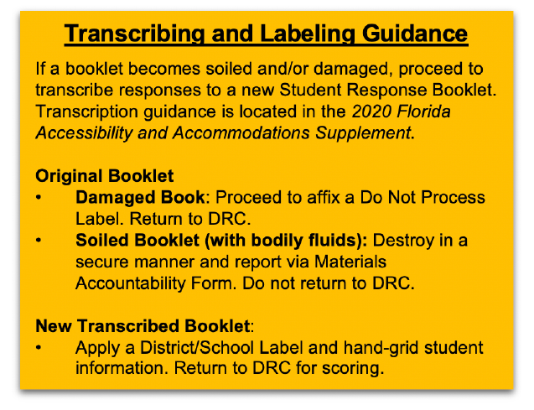
Do Not Process Labels
Guidelines
Place on top of other labels in the upper right hand corner, if needed.
Will not be scored; do not use this label to invalidate a test.
For use on damaged booklets that should be returned to DRC (Except bodily fluids).
Transcribe student responses to a new book, if needed.
TAM, p. 30

Slide 82
SCHOOL TEST ADMINISTRATORS

Slide 83
Test Security Policies and Procedures
Florida Test Security Statute 1008.24 and Florida State
Board of Education – Test Administration and Security Rule 6A –
10.042 https://www.flrules.org/gateway/RuleNo.asp?ID=6A-10.042
M-DCPS: Standards, Guidelines, and Procedures for Test
Administration and Test Security http://oada.dadeschools.net/TestChairInfo/29testsecuritymanual.pdf
The security of all test materials must be maintained before,
during, and after the test administration.
Under no circumstances are students permitted to handle
secure materials before or after the test administration.
Test administrators MUST NOT administer ACCESS for ELLs to
their family members.
TAM, pp. 23 - 25

Slide 84
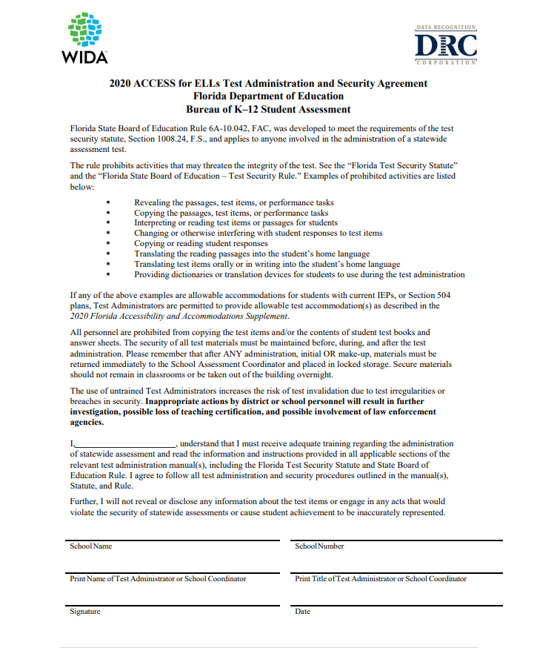
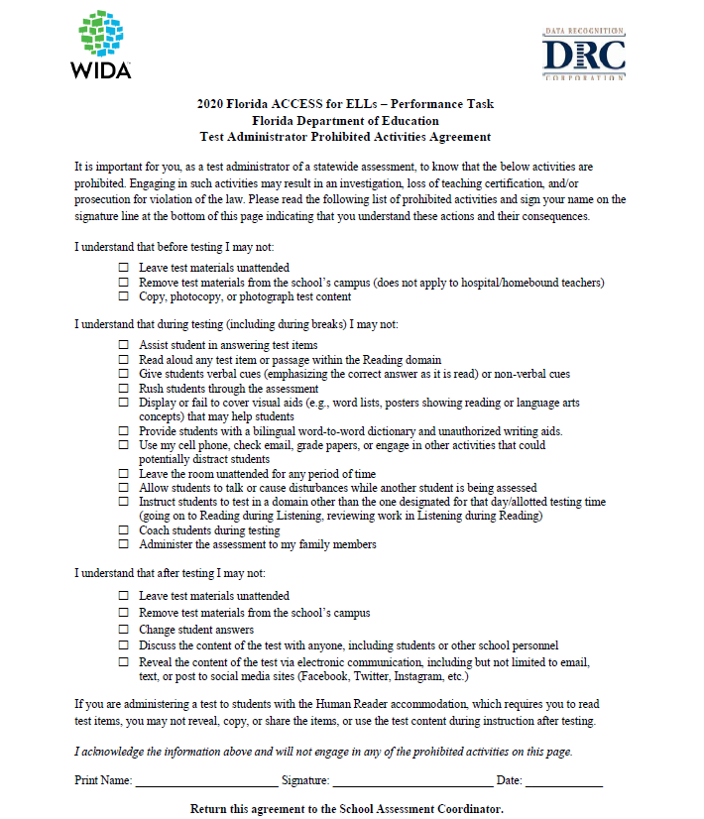
Test Security Policies and Procedures
Test Administration and Security Agreement
Test Administrator Prohibited Activities Agreement
Exclusively available in the Florida State Specifics Directions Document

Slide 85
Preparing for Testing:
Training Test Administrators
All Florida school assessment coordinators and test administrators must adhere to the following procedures:
Be proficient in English (listening, speaking, reading, and writing) to effectively apply the scoring rubric and evaluate students’ responses in English, as required.
Complete training modules via the WIDA Secure Portal and quizzes with a passing score of 80% or higher to become certified to administer the ACCESS for ELLs suite of assessments.
Complete the 2019 - 2020 Test Administration and Security Agreement
Complete the 2019 - 2020 Test Administrator Prohibited Activities Agreement
Review the Florida-Specific Test Administration Manual(s)
Have test administrators familiarize themselves with the Listening and Speaking Test CDs and equipment
Remind test administrators of the State’s and District’s security policies and procedures (including those concerning electronic devices)
TAM, p. 8

Slide 86
Preparing for Testing:
Training Test Administrators
Test Administrators should:
Properly account for test booklet security immediately before, during, and after test administration
Ensure students are provided accessibility supports and/or accommodations, as applicable.
Verify the accuracy of the student Pre-ID label and tier placement before placing on the Student Response booklet
Ensure that each student receives the Student Response booklet that has the correct name (label) and tier.
Administer group components of the test (Listening, Reading, and Writing)
Follow the Test Administrator’s Script verbatim
  Administer and score the Speaking component of the test
  Administer the Kindergarten and/or Alternate ACCESS test(s)
Ensure that all students are given the allowable time to complete the test.
Ensure ONLY a number 2 pencil is used on the Student Response Booklet.
Record the required administration information and students’ domain completion status.
Complete seating charts and other required information.
Complete Security Logs and post signs for every test session.
Maintain test security at all times, report security violations or invalidation concerns to the School Assessment Coordinator immediately.
Notes:
86

Slide 87
Preparing the Testing Room
The testing room should have:
  Comfortable seating for students
    No more than 22 students in a testing room
    Sufficient spacing between seats
      Not facing each other when seated at tables
    Good lighting
  Remove or cover all visual aids on desks or in the room that show reading or language arts concepts
  A sufficient number of #2 pencils
  “Do Not Disturb” and “No Electronic Devices” signs posted on the outside of the testing room door(s) during test sessions
  A functioning clock or watch to keep track of time
  Security Log
  Speaking Domain
  A quiet room with space for the student and test administrator
  Note: All students should be tested in the same manner
TAM, pp. 56 - 57

Slide 88
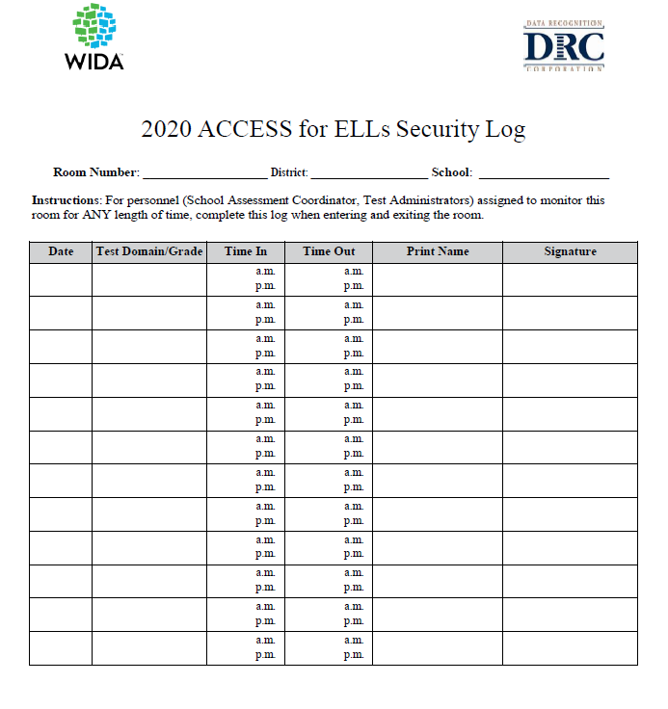
Test Security Policies and Procedures
ACCESS for ELLs Security Log
Each school is required to maintain an accurate ACCESS for ELLs Security Log for each testing room. Anyone who enters a testing room for the purpose of monitoring a test is required to sign the log.
  This applies to the Test Administrator and anyone who relieves a Test Administrator.
Exclusively available on Florida’s State Specific Directions Document

Slide 89
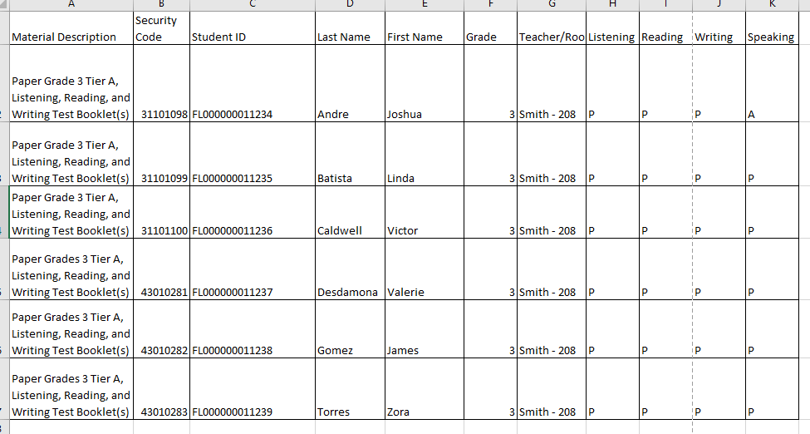
Test Security Policies and Procedures
Group Administration
Each test administrator is required to maintain an accurate account of the students that were tested for each domain.
Exclusively available on Florida’s State Specific Directions Document

Slide 90
ACCOMMODATIONS

Slide 91
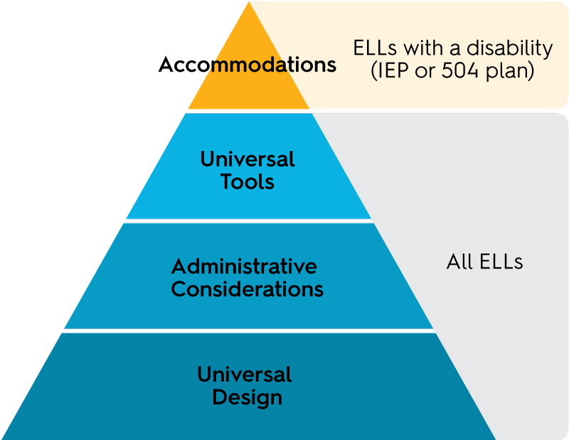
Accessibility and Accommodations
[Triangle width indicates estimated proportion of ELLs using each type of support]

Slide 92
Allowable ELL Accommodations
(all ELL Students)
The test administrator may:
Answer student procedural questions.
Answer content questions during practice items.
Monitor student progress to promote on-task behavior.
Rephrase, explain in English, or, if specifically requested, translate the test directions and practice items into the student’s native language.
Adjust the volume for student(s) if the audio is not loud enough.
Assist students with turning the page (during the Speaking test, especially at the younger grades).

Slide 93
Universal Tools
(available for all ELL students)
Universal tools are available to all students taking the ACCESS for ELLs suite of assessments
Audio aids
Color overlay
Highlighters, colored pencils, or crayons
Tracking Tool
Low-vision aids or magnification devices
Student Planning Sheet
Note: If these tools are not used regularly in the classroom, DO NOT use for testing.
Supplement, pp. 9-10

Slide 94
Accommodations Not Permitted on any ACCESS for ELLs Suite of Assessments
Students MUST NOT use a heritage to English dictionary
Reading aloud of test items, prompts, passages, and response options for students on the Reading
Translating or reading test items into a language other than English
Students MUST NOT have access to any unauthorized writing aids (i.e. word lists, spelling lists, lists of adjectives and adverbs, word definitions, punctuation charts, translation devices, or organizational patterns)

Slide 95
Preparing for Testing:
Accommodations for SPED Students
Students with a current IEP or 504 plans are eligible for accommodations based on their individual needs.
An accommodation for a student must be explicitly permitted on the IEP or 504 plan, and may include:
Presentation of Test Materials
Response to Questions
Test Environment/Setting Accommodations
Timing/Scheduling Accommodations
Assistive Devices
TAM, pp. 11 – 27 & 32 - 34

Slide 96
Human Reader Accommodation Script
The Human Reader Accommodation Script is used only for the Listening and Speaking portions of the ACCESS for ELLs Paper Assessment for Grades 1 – 12. (those administered via CD)
The student must have a documented disability to use ANY of the Human Reader accommodations.
Does the student use the accommodation on a regular basis to address his or her learning challenges in the classroom during instruction and testing?
2. Is this accommodation documented in the student’s IEP or 504 plan?
NOTE: The dialogue in the Listening and Speaking human reader scripts may require two trained test administrators to deliver this accommodation because it involves modeled dialogue between a sample student and a test administrator.
Accommodations Supplement, pp. 11-12, 17-19

Slide 97
Ordering Human Reader
Accommodation Scripts
  Human Reader Accommodation Scripts will also be ordered through Google Forms for very rare circumstances.
  Unlike the regular paper-based test orders, all Human Reader Accommodation Script orders MUST be approved by Felicia Mallory or Denetra Collins.
  Due to the required approval process, please wait until you receive an email confirming that your order is ready to be picked up.

Slide 98
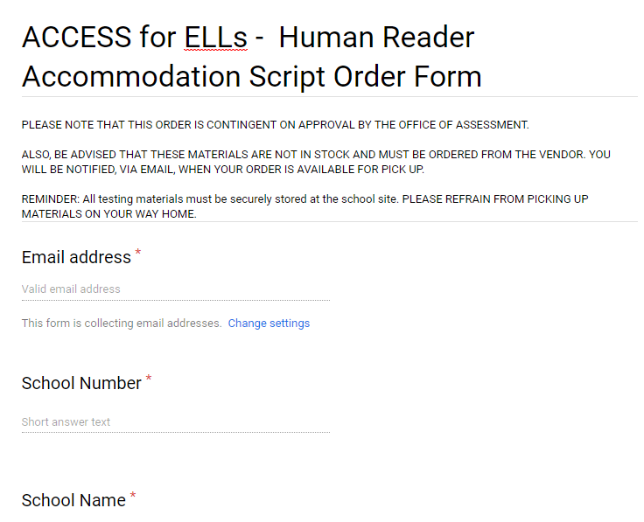
Ordering Human Reader
Accommodation Scripts (cont.)
http://oada.dadeschools.net/TDC/TDC.asp

Slide 99
Preparing for Testing:
ESE Accommodations for Eligible ELLs
Presentation
Read aloud, as permitted
Repeat test items by human reader
Large print version of the test
Braille version of the test
Test Environment and Setting
Small Group
Separate Room with preferential or adaptive seating
Timing/Scheduling Accommodations
Extended Speaking test response time
Extended testing time within the school day
Extended testing of a test domain over multiple days

Slide 100
ACCESS Materials for Students’ Use
Large Print/Braille Materials
Guidelines:
The student must be proficient in the use of Braille
Braille graphics will be included with the Braille edition, where appropriate.
The student may be oriented to the Braille graphic by the Test Administrator
Student responses on the Braille Reading and Writing must be transcribed verbatim into a regular test booklet.
Braille and the regular test materials must be included in the return shipment.
Note: The Test Administrator will also need a regular-print version of the test booklet that matches the Braille level being administered.

Slide 101
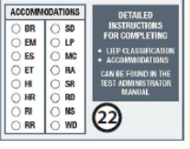
ACCESS Materials for Students’ Use
Large Print/Braille Materials (cont.)
Box 22

Slide 102
Special Test Documents
Large Print and Braille
ACCESS for ELLs is available in the following accommodated versions:
Kindergarten ACCESS for ELLs and ACCESS for ELLs (Grades 1–12)
Large print version is based on the regular print version.
ACCESS for ELLs (Grades 1–12) – Tier B/C ONLY
Reading and Writing sections are available in Braille only for students taking the Tier B/C test form of ACCESS for ELLs. The Braille tests are provided in contracted and uncontracted Braille format.
Large print and Braille test materials arrive with the regular test materials. Test Administrators must be trained in the use of the accommodated versions.
Accommodations Supplement, pp. 4 & 14

Slide 103
ELLs Identified as
Deaf or Hard-of-Hearing
Students who are deaf and unable to produce spoken language should be exempted from the Listening and Speaking sections.
Listening – Students who are deaf and receive language input only through signing should be exempt from Listening section.
Speaking – Students who are not able to produce spoken language should be exempt from the Speaking section.
Reading and Writing – Test Administrators may sign the directions and may use signing to answer any questions the students have about the directions. However, administrators may NOT use signing to explain content of the Reading or Writing questions.
  If this exemption is used, grid L and/or S on the booklet next to SPD in the Do Not Score This Section for this Student box.

Slide 104
Kindergarten ACCESS for ELLs
Overview

Slide 105
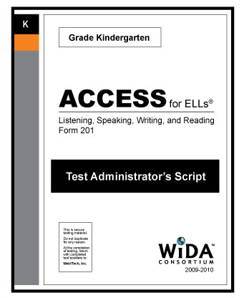
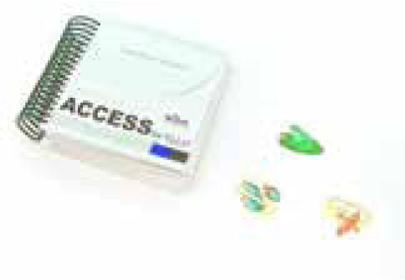
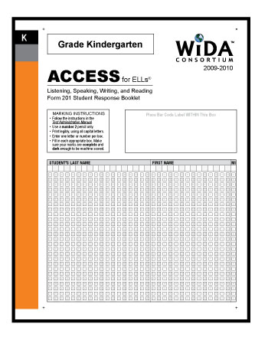


Kindergarten Testing Materials
Student Story Booklet
Student Response Booklet
Test Administrator’s Script
Student Activity Board
Cards & Card Pouch Booklet
Notes:
105
105

Slide 106
Test Design Features (Kindergarten)
Test items are thematically centered, based on a particular type of text, and divided into two sections:
  Narrative (Parts A – C)
    Part A: Listening and Speaking
    Part B: Writing
    Part C: Reading
  Expository (Parts D – F)
    Part D: Listening and Speaking
    Part E: Writing
    Part F: Reading
Note: Both sections of the test must be administered in this order.

Slide 107
Summary of Testing Procedures, Kindergarten
Domain | Kindergarten - ACCESS for ELLs Paper
Listening and Speaking | Listening and Speaking are administered consecutively for each level of Part A and Part D until the student reaches a ceiling in both Listening and Speaking.
Writing | Scored by the Test Administrator using Writing Rubric.
 | This is the only component of the Kindergarten ACCESS for ELLs in which the students directly record their responses in the Student Response booklet.
Reading | Reading tasks are presented to the student using manipulatives.

Slide 108
Test Administration Procedures
Listening and Speaking
Kindergarten
Listening and Speaking are presented in an interview format (NO CD delivery)
  The room should be quiet and free of distractions.
  The test administrator should sit at a right angle to the student, preferably the test administrator’s right side.
  Two sharpened, number 2 pencils are needed.
  Test Administrator’s Script should be read verbatim.
Listening
  Close-ended responses
  Speaking – interview format
  Listening and Speaking are administered consecutively for each level of Part A and Part D until the student reaches a ceiling in both Listening and Speaking.

Slide 109

Kindergarten General Procedures
Read aloud black bold and blue bold text
  Although the Test Administrator must adhere to the script, sometimes encouragement, or rephrasing or clarification of a task per the script, is appropriate.
Record student scores IMMEDIATELY
10-min stretch break is scripted between Part C and Part D.
Test may be administered in two sessions with a less-than-two-day break between the parts
Winding Down when a “ceiling” is reached at one level.

Slide 110
Test Administration Procedures
Writing
Kindergarten
Scored by the Test Administrator
This is the only component of the Kindergarten ACCESS for ELLs in which the students directly record their responses in the Student Response booklet.
Consists of two parts(B and E) associated with the two different text types, narrative and expository, that are used in the test.

Slide 111
Test Administration Procedures
Reading
Kindergarten
Reading tasks use manipulatives to engage the students.
Test Administrator Script must be followed.
The Reading test consists of two Parts C and F associated with the two different text types, narrative and expository, used in the test.

Slide 112
ACCESS for ELLs
(Grades 1–12)
Overview

Slide 113
Test Overview
The ACCESS for ELLs will assess each of the four language domains of Listening, Speaking, Reading, and Writing separately.
Paper Grade-Level Clusters: 1, 2, 3, 4–5, 6–8, 9–12
The Speaking section is individually administered and scored by the Test Administrator who will use a rating scale compared to a model response.
The Listening, Reading and Writing domains can be group-administered and are centrally scored by DRC.
The Listening and Speaking domains are media-delivered on one CD that includes all directions and pre-recorded prompts.
Accommodated Formats: Large-print and UEB Braille (Contracted and Uncontracted for Tier B/C and only for Reading, Writing and Listening sections)

Slide 114




Paper Test Materials Overview
Test Administrator’s Script
Student Test Booklet
Speaking Test Booklet
Listening/Speaking CD

Slide 115
Approximate Test Administration Timing
ACCESS for ELLs - Grades 1 - 12
Time to… | Listening | Reading | Writing |  |  | Speaking
Seat students, distribute test materials, etc. | 15 – 20 minutes (depends on group size)
Give test directions and allow students to complete practice items | 10 minutes | 5 minutes | 5 – 10 minutes
Allow students to complete test items | 25 – 40 minutes | 35 – 45 minutes | Grade 1 Tier A | Grades 2 – 12 Tier A | Grades 1 – 12 Tier B/C | 15 – 35 minutes
 |  |  | 35 minutes | 60 minutes | 65 minutes
Total test administration time (for planning purposes) | 65 minutes | 60 minutes | 65 minutes | 90 minutes | 95 minutes | 65 minutes
Anticipate 15 – 20 minutes for Convening and Dismissing the students and test set up depending on the group size. Less for the Speaking portion since it is individually administered.
TAM, p. 101

Slide 116

Pausing or Discontinuing A Paper Test
Listening and/or Speaking Domains
In the case there are technical difficulties or a disruption during the Listening or Speaking Test:
Unusual circumstances or audio issue
  Discontinue domain after 2nd attempt for an individual student
  Leave remaining items blank
  No additional label needed (i.e., Do Not Process)
TAM, pp. 105 - 106

Slide 117
Listening Domain Administration
ACCESS for ELLs - Grades 1 - 12
Materials Needed: Test Administrator’s Script, Student Response Booklet, Listening and Speaking Test CD, Number 2 pencil, CD Player or desktop/laptop computer (to play the CD), Speakers
Requires a portable CD player, computer, or laptop with speakers
  If you are using a computer or laptop check the CD Drive and volume control settings by clicking on the speaker icon located at the bottom right hand side of the tool bar.
  Make sure the balance and speaker settings are set appropriately and that the mute option or radio button is unchecked.
Test the volume controls prior to administration
  Ensure that it is audible throughout the test administration room
  Check that the speakers are free from static or noise
Ensure that the AC power cord is attached or batteries are available if you are using a portable CD player
TAM, pp.106-107

Slide 118


ACCESS for ELLs - Grades 1 – 12
Listening Domain
CD Run Times
Approximately 16 to 32 minutes to administer (Tier B/C will take longer than Tier A)
TAM, pp. 107 - 108

Slide 119

Listening Test Introduction, Practice & Information
Practice the Test Administrator’s Script ahead of time.
Do not read any answer choices out loud
Once the Listening test has begun, do not stop or pause the audio
  25 seconds response time is included in the audio files
  Tone to alert next prompt/question
  Check-in time is included
Pause only in the case of a significant interruption
  Exact guidelines in Test Administration Manual
  Current item less than 15 minutes vs. current part more than 15 minutes
TAM, pp. 108 - 109

Slide 120
Test Administration Procedures
Grades 1 – 12
Reading Domain
Materials needed: Test Administrator's Script, Student Response Booklets, number 2 pencil.
Test is designed to take approximately 35 – 45 minutes to be administered.
Follow the Test Administrator’s Script verbatim
Circulate through the testing room
Perform check-ins as indicated by stop signs in the test booklets.
  Whole group check-ins should be performed simultaneously with all students and explain the next part of the test.
  Individual check-ins occur when students raise their hand when they arrive at a stop sign.
TAM, pp. 110 - 112

Slide 121

Monitoring the Reading Test
Circulate through the testing room
Perform check-ins as indicated by stop signs in the test booklets.
  Whole group check-ins should be performed simultaneously with all students.
  Individual check-ins occur when students raise their hand as they arrive at a stop sign.
NOTE: Follow the Script Verbatim

Slide 122
Test Administration Procedures
Grades 1 – 12
Writing Domain
Materials needed: Test Administrator’s Script, Student Response Booklets, Number 2 pencil, Student Planning Sheet
Follow the Test Administrator’s Script verbatim.
Make sure students begin the Writing test on the appropriate page.
Circulate the room to monitor students’ progress after 10 minutes and 30 minutes.
Perform check-ins as indicated by stop signs in the test booklets.
  Whole group check-ins should be performed simultaneously with all students.
  Individual check-ins occur when students raise their hand as they arrive at a stop sign.
TAM, pp. 112 - 115

Slide 123
Test Administration Procedures
Writing
Grade 1 Tier A
Organization, Content, and Timing Guidelines Per Task
 | WIDA English Language Development Standard | Time | Extra Time
Part A | Social and Instructional Language | 5 minutes | Additional five (5) minutes to finish writing may be given to the students at the end of Part D
Part B | Social and Instructional Language | 5 minutes
Part C | Social and Instructional Language | 10 minutes
Part D | Social and Instructional Language | 10 minutes
Total allowable time – 35 minutes

Slide 124
Test Administration Procedures
Writing
Grades 2, 3, 4-5, 6-8, and 9-12 – Tier A
Organization, Content, and Timing Guidelines Per Task
 | WIDA English Language Development Standard | Time | Extra Time
Part A | Social and Instructional Language | 15 minutes | 5 minutes if needed
Part B | Language of Language Arts | 15 minutes | 5 minutes if needed
Part C | Language of Math/Language of Science | 15 minutes | 5 minutes if needed
No additional time is allowed beyond the extra time allotted for each part of the test Total allowable time – 60 minutes

Slide 125
Test Administration Procedures
Writing
All Grades - Tier B/C
Organization, Content, and Timing Guidelines Per Task
 | WIDA English Language Development Standard | Time | Extra Time
Part A | Social and Instructional Language | 10 minutes | Additional five (5) minutes to finish writing may be given to the students at the end of Part C
Part B | Language of Math/Language of Science | 20 minutes
Part C | Integrated Task (Language of Language Arts/Language of Social Studies/Social and Instructional Language) | 30 minutes
Total allowable time – 65 minutes

Slide 126

Monitoring the Writing Test
Circulate the room to monitor students’ progress after 10 minutes and 30 minutes.
Perform check-ins as indicated by stop signs in the test booklets.
  Whole group check-ins should be performed simultaneously with all students.
  Individual check-ins occur when students raise their hand as they arrive at a stop sign.
Notes:
126
126

Slide 127




Speaking Domain Information
(Individually Administered)
Media-delivered. Equipment needed: CD player and speakers.
Materials needed: Test Administrator’s Script, Speaking Test Booklet, CD, Student Test Booklet, and number 2 pencil.
Test administration should take place in a quiet room free of distractions.

Slide 128
Test Administration Procedures
Speaking Domain – Grades 1 – 12
Materials needed: Test Administrator’s Script, Student Response Booklet, Speaking Test Booklet, Listening and Speaking CD, number 2 pencil, CD Player or desktop/laptop computer (to play the CD), Speakers
Individually Administered
Approximately 15 to 35 minutes per student. Higher grade-level clusters and tiers will take longer.
Media-delivered - Equipment needed: CD player or computer and speakers.
Test administration should take place in a quiet room free of distractions.
Play each track only one time (without pausing, without moving ahead or skipping to the next track). The student may NOT listen to tracks again or look back at previous pages of his or her test booklet.
Allow the response time to play and DO NOT fast forward or skip to the next track even if the student has finished his or her response.
Help the student navigate the test (e.g., turn the page, respond when appropriate)
Follow the Test Administrator’s Script
Use a Number 2 Pencil ONLY
Only portion of ACCESS for ELLs for Grades 1 through 12 that is scored by the Test Administrator.
TAM, pp. 116 - 124

Slide 129

Administration Times
Speaking Domain
Grades 1 - 12
Takes approximately 15 to 35 minutes per student. Higher grade-level clusters and tiers will take longer.
TAM, pp. 119 - 120

Slide 130
Alternate ACCESS for ELLs
(Grades 1–12)
Overview

Slide 131
Alternate ACCESS for ELLs
Test Overview
Individually administered, semi-adaptive assessment.
Grade-Level Clusters: 1–2, 3–5, 6–8, 9–12
The Test Administrator scores all sections of this test.
All sections of the Alternate ACCESS for ELLs are semi-adaptive, which means that the administration of a test section should be ended if the student scores No Response, Incorrect, or Approaches on three consecutive tasks.
TAM, pp. 126 - 148

Slide 132



Alternate ACCESS for ELLs
Test Materials
Test Administrator’s Script
Test booklet (legal size paper)
Student Response Booklet

Slide 133
Test Administration Procedures
Alternate ACCESS for ELLs
Listening, Reading, Speaking, Writing
The test administrator needs each of the following for each domain:
Test Administrator’s Script
Listening, Reading, and Speaking Test Booklet
Student Response Booklet
#2 Pencil
Each domain approximately 20 minutes to administer

Slide 134
Who Should Administer the Alternate ACCESS for ELLs?
Teacher or licensed staff member familiar with student’s dedicated communication system and response modes
Practice ahead of time is important due to logistics of managing:
  Student Response Booklet
  Test Administrator’s Script
  Student Test Booklet
  Spring 2020 Florida ACCESS for ELLs Test Administration Manual
  Individual student supports
TAM, pp. 129 - 130

Slide 135
Anticipated Test Administration Times
Alternate ACCESS
Test Section | Number of Tasks | Approximate Time
Listening | 9 | 20 minutes
Reading | 9 | 20 minutes
Speaking | 8 | 20 minutes
Writing | 10 | 20 minutes
Note: It is recommended to administer the test in this order.

Slide 136

SCHOOL ASSESSMENT COORDINATOR:
PACKING FOR RETURN

Slide 137
Material Return Procedures
Use the following steps in preparing all Student Response Booklets for return:
Verify that all (USED) booklets that contain student responses have the Pre-ID or District/School label affixed to the front of the Student Response booklet.
Verify that all booklets with the District/School (yellow) label have completed demographic pages on the front and back cover of the Student Response booklet.
    Make sure the student name has been written in the boxes and bubbled correctly.
    Make sure that the date that testing began has been filled in correctly.
    Make sure that all information in Section 4.6 of the TAM has been bubbled correctly.
    Make sure the correct grade is bubbled.
Remove any staples, paper clips, or sticky notes from the Student Response booklet.
Remove any planning sheets from the Student Response booklet and prepared for return.
If the Student Response booklet is UNUSED, do NOT place any labels on the booklet.
  If a Pre-ID or District/School label is placed on an UNUSED booklet, place a DO NOT PROCESS label OVER the existing label and return the booklet with the USED booklets.
Large Print and Braille Student Response booklets
Verify that student responses have been transcribed into a standard Student Response booklet.
Verify that a student Pre-ID label has been applied to the standard booklet or a District/School label was used and demographic information bubbled. Grid the accommodation field for BR or LP on the back on the booklet.
Return large print and/or braille booklets with the other test materials.
TAM, pp. 62 - 63

Slide 138
Material Return Procedures
Suggested Order for Packing Materials
USED Student Response Booklets by Grade and Tier, in plastic bag packages (with affixed Pre-ID labels, District/School labels, or Do Not Process labels)
  - FLVS Student USED Student Response Booklets (do not use your school’s labels)
All Test Administrator’s Scripts
Speaking Test Booklets
Listening and Speaking Test CDs
All USED and Unused large-print and Braille test materials (if received)
Alternate ACCESS for ELLs Listening/Reading/Speaking Test Booklets
Kindergarten ACCESS for ELLs Ancillary Materials
Human Reader Accommodation Scripts (if ordered)
USED Student Planning Sheets
Unused Student Response Booklets (no label needed for UNUSED booklets)
Defective Materials (if applicable)
Note: Place Unused Student Response Booklets
at the Bottom of the Box

Slide 139

Material Return Procedures
Open and inventory the Return Materials Instruction Packet. This contains directions and DRC return shipping labels, and (UPS shipping labels are found in the an envelope sent with the initial shipment)
Use the boxes from the original shipment.
Place all materials within the protective, plastic DRC shipment bags. (To be scored documents are the priority.)
Seal the return shipping bag with one of the provided plastic ties.
Use crumpled paper or bubble wrap to ensure that materials do not shift.
Affix a DRC return shipping label to Flap A and verify that the label has the correct district/school name and address.
Affix a UPS return label to flap B of each box.
Seal boxes securely using heavy duty shipping tape.
TAM, p. 63

Slide 140
Scheduling Pick-Up with
United Parcel Service (UPS)
Schedule your ACCESS for ELLs at least one day prior to
your desired date. (last pickup date is March 20, 2020)
Contact UPS at 1-866-857-1501, specify that you are using pre-paid return labels.
- Count your boxes and advise UPS of that count
- Make a note of the UPS Tracking number for each package
Follow instructions on page 64 of the Test Administration Manual
TAM, p. 64

Slide 141

ACCOUNTING FOR ALL
ACCESS for ELLs
http://oada.dadeschools.net/TDC/TDC.asp
Additional Resources

Slide 142

http://oada.dadeschools.net/TDC/TDC.asp
Additional Resources
District Assessment Coordinator Envelope

Slide 143
2019 Student Score Reports
Individual Student Report (ISR): This report provides information about the student’s scores on the ACCESS for ELLs English proficiency test. Scores are reported as Proficiency Levels and as Scale Scores of four individual language domains and combined domains.
  Note: For Kindergarten ACCESS for ELLs ONLY, there is also a separate Parent/Guardian Report that is exclusively online via WIDA AMS. The Parent/Guardian Report provides the same information as the ISR.
Score reports will be delivered to schools
Reports should be distributed in the following manner:
  The copy received should be sent home with the student
    Schools will have access to the WIDA AMS to download School Roster Reports, ISR, and School Frequency Reports

Slide 144



Parent/Guardian Resources
Notification Letter in English and Spanish
Parent Handouts in 6 Languages for ACCESS for ELLs and Alternate ACCESS for ELLs (available in Resource Library)

Slide 145
District Resources
Assessment, Research, and Data Analysis Website: http://oada.dadeschools.net/
Test Chairperson Website: http://oada.dadeschools.net/TestChairInfo/InfoForTestChair.asp
Testing Calendar (check for updates regularly): http://oada.dadeschools.net/TestingCalendar/TestingCalendar.asp
Guidelines and Tips for School Test Chairpersons:
  http://oada.dadeschools.net/TestChairInfo/27GuidelinesandTipsforSchoolTestChairpersons.pdf
Standards, Guidelines, and Procedures for Test Administration and Test Security:
  http://oada.dadeschools.net/TestChairInfo/StandardsGuidelinesandProceduresMay2013.pdf

Slide 146
ACCESS for ELLs
Division of Bilingual Education and World Languages
North Region
Deland Innocent, Supervisor
305-995-2977
Dinnocent@dadeschools.net
South Region
Mercy Abadie Lux, Supervisor
305-995-2098
Mabadie@dadeschools.net
Central Region
Alina Plasencia, Supervisor
305-995-2433
Aplasencia@dadeschools.net
Charter Schools
Mariana Boffill, Supervisor
305-995-1327
Bofillm@dadeschools.net

Slide 147
Contact Information
STUDENT ASSESSMENT AND EDUCATIONAL TESTING
Felicia Mallory
Fmallory@dadeschools.net
Denetra Collins
CollinsD@dadeschools.net
305-995-7520
Fax – 305-995-7522

